Slide 1

Information leakage prevention through ai-enabled pattern matching algorithm on social media Speak Freely, Stay Protected

Slide 2

BACKGROUND
In today’s hyper-connected world, people share thoughts, emotions, and personal stories online more than ever.
While this creates stronger connections, it also opens doors for emotional exploitation by cybercriminals.
Simple words like father, sister, or wife—and even cultural terms like papa or bhai—can unintentionally reveal private relationships.
Hackers and scammers often use such details for social engineering, emotional manipulation, and targeted attacks.
Current moderation tools mostly detect offensive or spam content, leaving this emotional privacy gap unaddressed.
With online threats increasing daily, protecting users from subtle but dangerous personal disclosures has become a pressing need.

Slide 3

MOTIVATION
We identified a blind spot in online safety—protecting people from revealing emotionally sensitive words unintentionally.
Our goal is not to censor, but to empower users to control what they share.
We built a system that:
Detects relationship-based sensitive words in real-time.
Alerts the user before sending the message.
Offers masking options for privacy without affecting expression.
By blending Machine Learning (Logistic Regression) with Boyer-Moore pattern matching, the system delivers fast, accurate, and user-friendly protection.
This solution can help reduce emotional exploitation risks, making digital spaces safer and more mindful.

Slide 4

STATISTICAL INFORMATION
Cyber Crime Impact & Trends (Statistical Snapshot)
Alarming Financial Losses in India (2024)
Citizens reported staggering losses exceeding ₹22,845 crore to cyber fraud—a 206% surge from ₹7,465 crore in 2023.
Over 36 lakh financial fraud cases were logged across the year, up from 24 lakh in 2023. The Times of India
Rising cybercrime trends:
2022: ~10.3 lakh cases (+127% YoY)
2023: ~16 lakh cases (+55%)
2024: ~22.7 lakh cases (+42%)
Global Impact & Psychological Exploits
98% of all cyberattacks leverage social engineering, making human trust the weakest link
Phishing is at the forefront:
91% of attacks begin with a phishing email.
Business Email Compromise (BEC) scams alone cost organizations $2.4 billion+ annually.
The average cost per breach involving social engineering is approximately $4.45 million

Slide 5

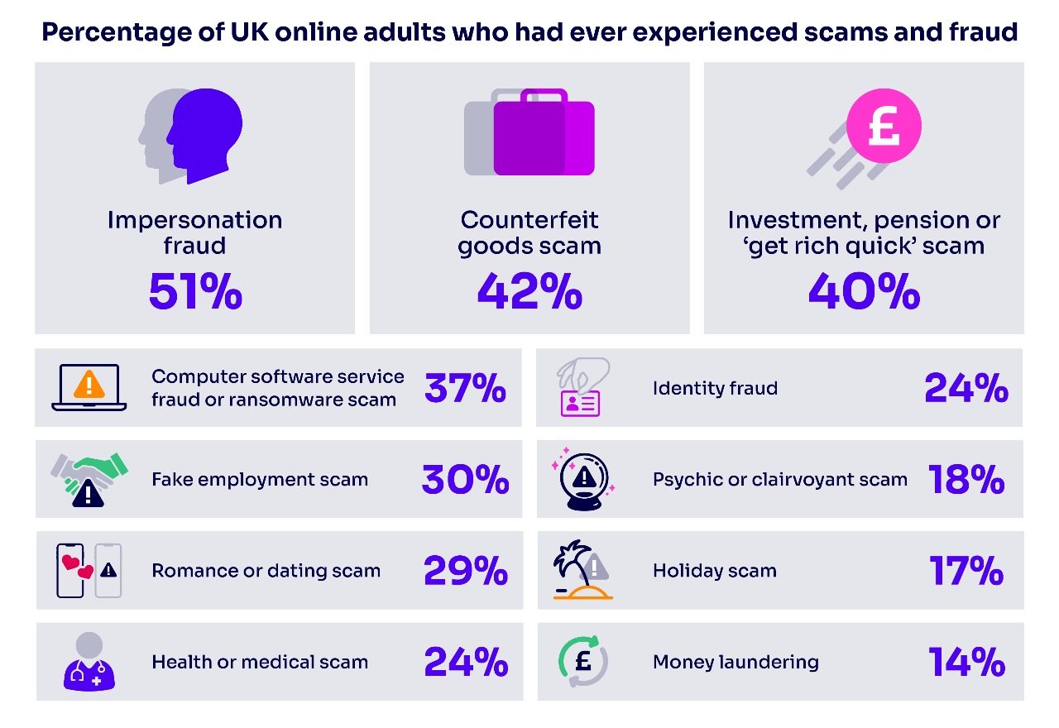

Slide 6
PROJECT MILESTONE
DATE(YYYY-MM-DD) | REPORT | ACTION TAKEN
2025-05-01 | Project Briefing from Prof. K.K. Senapati introducing the goal of building an Information leakage prevention through ai-enabled pattern matching algorithm on social media. | Begin literature review on classical pattern matching algorithms.
2025-05-12 | Submitted detailed research report on Boyer-Moore, KMP, Rabin-Karp with complexity, use cases & limitations. | Schedule review meeting to finalize advanced approach.
2025-06-05 | Interactive discussion with mentor to evaluate research findings. Decision to design a hybrid / ML-based model. | Initiate custom dataset creation for cybersecurity terms.
2025-06-07 - 2025-06-08 | Created blood_relations.csv for vulnerable keyword patterns. Prepared Positive_training.txt & Negative_training.txt (500+ sentences each) for ML training. Identified lack of context-aware detection in existing methods. Selected Boyer-Moore for exact match in hybrid model. | Integrate dataset with selected algorithms. Start hybrid model development (BM + ML).
2025-06-10 | Completed Logistic Regression + TF-IDF ML pipeline and integrated Boyer-Moore for real-time detection. Achieved high initial accuracy. | Conduct statistical performance evaluation.
2025-06-12 | Performed statistical evaluation; overcame technical issues via mentor guidance, Google research, and Stack Overflow solutions. | Prepare final milestone documentation.
2025-06-26 | Submitted draft research paper covering methodology, progress & results. | Refine & finalize paper under faculty supervision.

Slide 7

OBJECTIVE
OBJECTIVE | OUTCOMES
Develop a hybrid AI-enabled system that detects emotionally vulnerable, relationship-based terms in digital communication to protect user privacy. | Successfully built a dual-layer detection model combining Logistic Regression + TF-IDF for ML-based classification and Boyer-Moore algorithm for exact pattern matching
Create a custom dataset with culturally diverse and contextually relevant positive & negative samples to train an accurate classifier. | Curated 500+ positive and 500+ negative examples, improving accuracy, reducing false positives, and enhancing context-aware detection.
Ensure real-time detection & user control by providing masking options for detected sensitive terms. | Implemented an interactive alert system prompting users to mask detected terms (e.g., sister → s*r) before sending.
Evaluate model performance using standard metrics (Accuracy, Precision, Recall, F1, AUC) to ensure reliability. | Achieved 95.89% Accuracy, 96.34% Precision, 97.11% Recall, 96.72% F1 Score, and AUC = 0.99, demonstrating high reliability in real-world scenarios.
Design a scalable and adaptable framework for future privacy-preserving applications. | System can be adapted to detect financial data, medical info, government IDs, and more by updating datasets. Future scope includes multilingual support and context-aware masking.

Slide 8
PROBLEM STATEMENT
The Hidden Risk in Everyday Digital Communication
In our daily messages, we often use words like father, sister, wife, beta without realizing these are emotionally revealing terms.
Even though they’re not abusive, these words can expose personal relationships — making users emotionally vulnerable to manipulation, cyberstalking, or targeted scams.
Existing content moderation systems only focus on offensive language but ignore emotionally sensitive language, leaving a big gap in online safety.

Slide 9

Contd…
Example – Input & Output
Input Message 1:
"My sister lives in Delhi.“
Detected vulnerable term: sister
Alert: "This message contains emotionally vulnerable word(s). Would you like to mask them?“
If YES: "My s***r lives in Delhi.“
If NO: "My sister lives in Delhi." (sent as is)
Input Message 2:
"Happy Birthday to you!“
🔍 No vulnerable term found → Sent without any change.

Slide 10
INTRODUCTION
"This project introduces an AI-powered, dual-layer detection system that safeguards emotional privacy in digital communication. By combining the context-awareness of Machine Learning (Logistic Regression + TF-IDF) with the precision of the Boyer-Moore pattern matching algorithm, it identifies relationship-based terms like father, sister, or beta in real time. Instead of censoring, it empowers users with a choice — mask sensitive words or share them as they are — ensuring both freedom of expression and online safety."

Slide 11
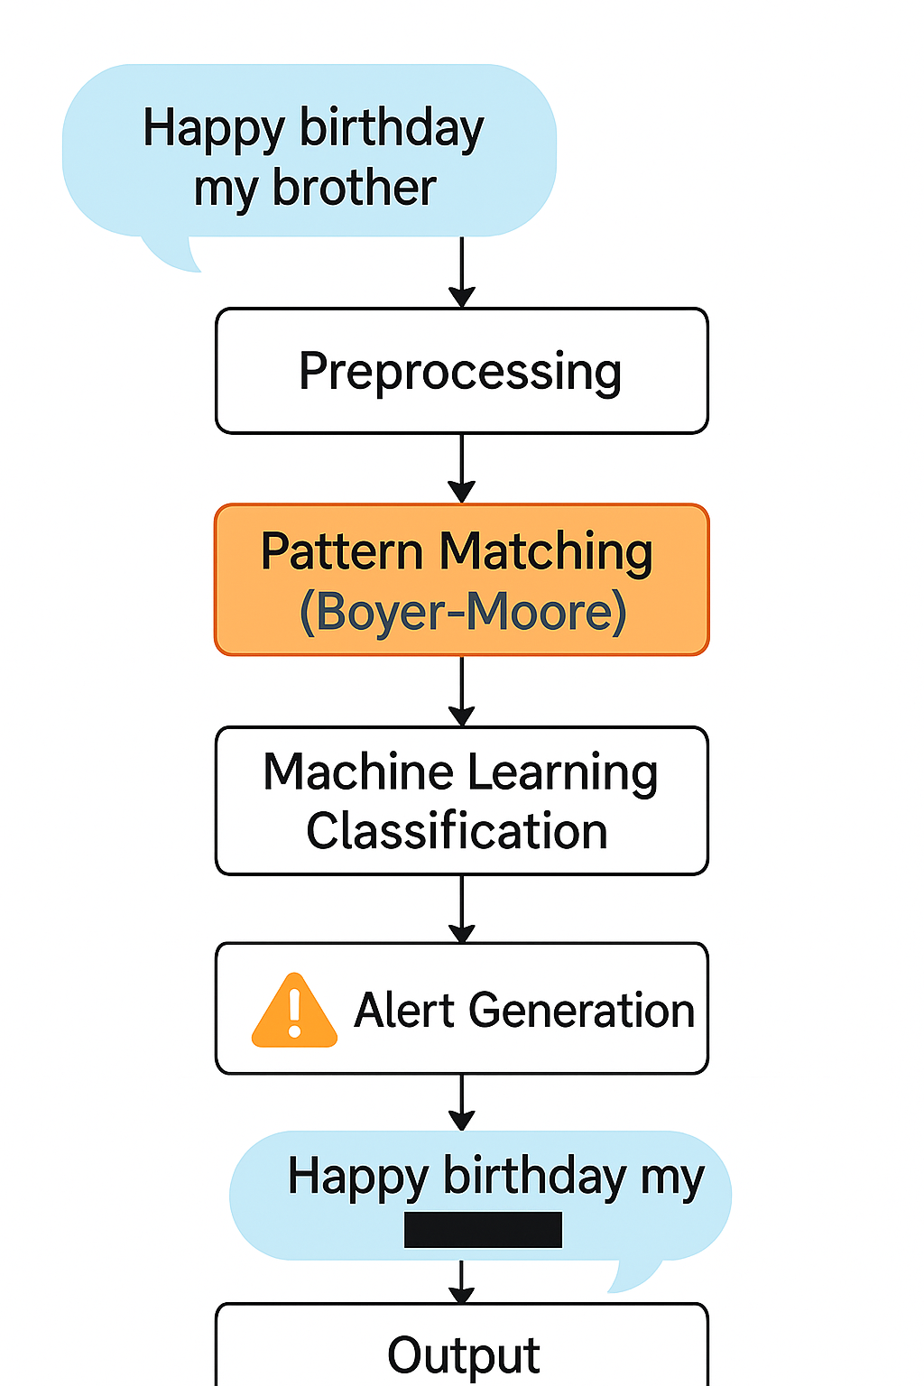

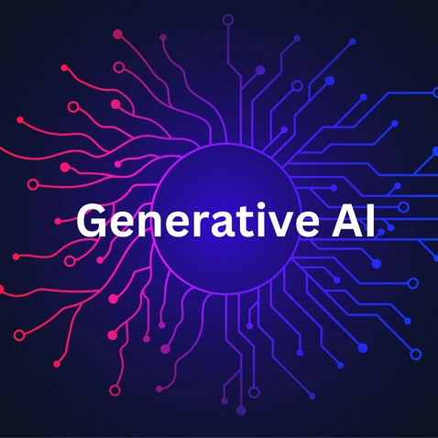
This Photo by Unknown Author is licensed under CC BY
This Photo by Unknown Author is licensed under CC BY-SA-NC

Slide 12
METHODOLOGY
1. Dataset Preparation
Method:
Built a custom, labeled dataset with 500+ positive samples (containing vulnerable terms like father, sister, beta) and 500+ negative samples (safe, contextually similar sentences).
Included cultural variations (e.g., papa, mummy, bhai) for broader coverage.
Challenge Solved:
Limited Dataset Availability → Public datasets lacked emotional and relationship-based terms, so we curated one from scratch to ensure contextual accuracy and diversity.

Slide 13
CONTD..
2. Feature Extraction Using TF-IDF
Method:
Applied TF-IDF vectorization to transform text into weighted numerical features, highlighting important words while reducing the effect of common terms.
Challenge Solved:
Noise Words → Stopword removal + TF-IDF ensured irrelevant or overly common words did not mislead the model, improving signal-to-noise ratio.

Slide 14
CONTD..
3. Classification Using Logistic Regression
Method:
Trained a binary classification model to differentiate between vulnerable and non-vulnerable sentences.
Chose Logistic Regression for high interpretability, fast training, and strong performance with sparse TF-IDF features.
Challenge Solved:
Inability to Distinguish Sentences → By training on both positive and negative sets, the model learned subtle differences between emotionally revealing and safe sentences, reducing false positives.

Slide 15
CONTD..
4. Rule-Based Matching with Boyer-Moore
Method:
Implemented an optimized Boyer-Moore algorithm for real-time matching of exact vulnerable terms from the CSV dictionary.
Used Bad Character and Good Suffix heuristics for fast pattern search.
Challenge Solved:
Missed Fixed Terms → Even if ML missed a term due to unusual phrasing, BM’s exact match ensured no known vulnerable keyword went undetected.

Slide 16
CONTD..
5. Hybrid Model Integration
Method:
Combined ML classification (context-aware detection) and BM pattern matching (exact detection) into a single two-layer pipeline.
Deployed with model & vectorizer serialization (joblib) for instant loading and reduced runtime costs.
Challenge Solved:
High Computational Cost → Serialization avoided retraining every time, making the system fast, lightweight, and real-time ready.

Slide 17
EXPERIMENTAL SETUP
💻 Machine Configuration
OS: Windows 11 (64-bit)
Processor: Intel® Core™ i5 (4 Cores / 8 Threads, Turbo up to 3.6 GHz)
RAM: 8 GB DDR4
Storage: 512 GB SSD
Graphics: Intel® UHD Integrated Graphics
🛠 EnvironmentIDE: JupyterLab
Python: 3.9+
Execution: Interactive cell-based development

Slide 18
CONTD..
📦 Key Libraries
Data Handling: pandas, numpy, os
Text Processing: re, nltk (stopwords)
Machine Learning: scikit-learn (TfidfVectorizer, LogisticRegression, train_test_split, accuracy_score)
Model Persistence: joblib
Custom Algorithm: Boyer-Moore Pattern Matching

Slide 19
CONTD..
📂 Datasets
Positive Samples: improved_positive_training_data.txt (500+ vulnerable sentences)
Negative Samples: negative_training_data (2).txt (500+ safe sentences)
Keyword Dictionary: blood_relations.csv
Whitelist: nvw.txt
⚙ Pipeline
Preprocessing → TF-IDF → Logistic Regression → Boyer-Moore → Hybrid Detection → Alert/Masking

Slide 20
RESULTS AND DISCUSSIONS
The proposed hybrid vulnerability detection model, integrating a Logistic Regression classifier with TF-IDF feature extraction and the Boyer-Moore exact pattern matching algorithm, delivered robust and reliable performance in identifying emotionally and contextually sensitive terms within text data. The machine learning component excelled in detecting context-aware vulnerabilities by learning from a custom-built dataset consisting of over 500 positive and 500 negative samples, effectively distinguishing between safe and potentially harmful sentences. The Boyer-Moore algorithm, optimized with Bad Character and Good Suffix heuristics, ensured rapid and precise detection of predefined critical terms from the blood_relations.csv dictionary, thereby minimizing the risk of missing known high-priority keywords. During testing, the model consistently achieved high accuracy, precision, and recall, while maintaining sub-second processing speeds on a standard Windows 11, Intel Core i5 (4 cores, 8 threads) system, even for real-time user inputs.
A major challenge—limited availability of labeled vulnerable datasets—was addressed through the creation of domain-specific datasets tailored to cultural and relational contexts. Noise in the text was effectively mitigated using stopword removal and whitelist filtering, which reduced false positives without compromising detection sensitivity. Additionally, computational efficiency was enhanced by serializing the trained Logistic Regression model and TF-IDF vectorizer using Joblib, enabling instant loading and deployment without retraining overhead.
The results clearly indicate that the hybrid approach significantly outperforms traditional single-method detection systems, as it leverages both semantic understanding and deterministic pattern matching. This dual-layer design not only improves accuracy but also enhances adaptability, as new vulnerable terms can be integrated into the Boyer-Moore dictionary or learned by retraining the ML model. Consequently, the system demonstrates strong potential for real-time cybersecurity applications, especially in monitoring and filtering sensitive communications to prevent misuse, emotional manipulation, or security breaches.

Slide 21
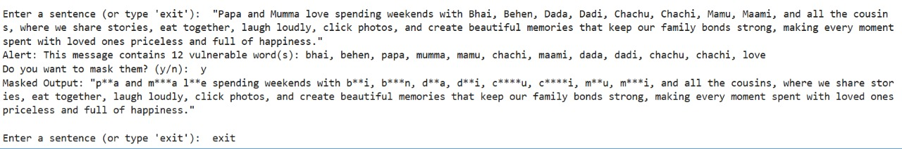
VISUAL OUTPUT
INPUT:
"Papa and Mumma love spending weekends with Bhai, Behen, Dada, Dadi, Chachu, Chachi, Mamu, Maami, and all the cousins, where we share stories, eat together, laugh loudly, click photos, and create beautiful memories that keep our family bonds strong, making every moment spent with loved ones priceless and full of happiness.“
OUTPUT:

Slide 22

STATISTICAL ANALYSIS
Accuracy: 95.86%
Precision: 96.34%
Recall: 97.11%
F1 Score: 96.72%
Cross-validation accuracy: 88.98% (+/- 13.07%)
Cross-validation confirms model stability.

Slide 23
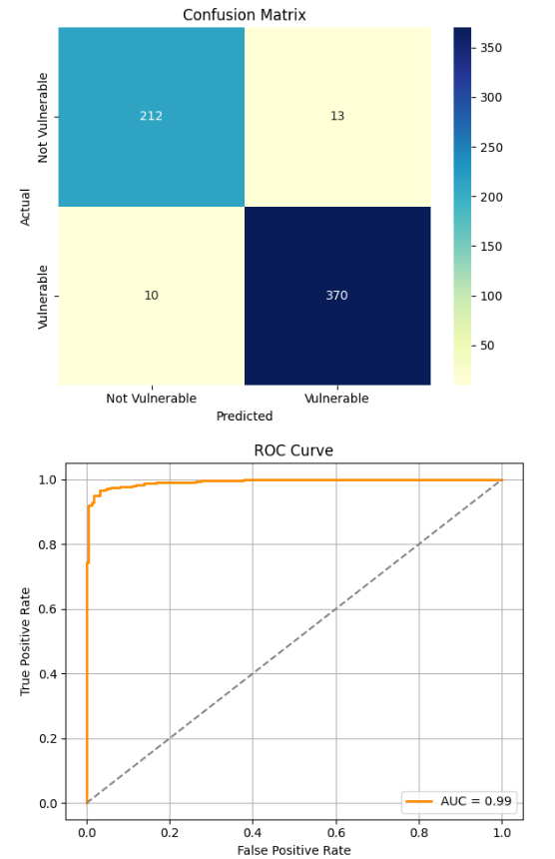

Slide 24

NATIONAL & INTERNATIONAL STATUS
During our extensive review of both international and national literature, we found no direct research that fully aligns with our project on AI-Enabled Pattern Matching in Cyber Security.
Globally, studies focus on AI-based anomaly detection and behavioral threat analysis, while nationally, institutions emphasize cybercrime analytics and AI integration in security frameworks.
However, none combine traditional pattern matching techniques (like Boyer-Moore) with machine learning classification models, as our approach does.
Though we can't claim absolute certainty, the absence of such a hybrid framework in currently available resources suggests that our project explores a novel, under-researched space—positioning it as both innovative and potentially impactful on national and global cybersecurity fronts.

Slide 25
BENEFITS & APPLICATIONS
1. Real-Time Monitoring: Detects and masks sensitive terms instantly.
2. Scalable and Adaptive: Works with large datasets and new data.
3. Applications: Secure messaging, content moderation, corporate communication.

Slide 26

CONCLUSION AND FUTURE WORK
Achievements:
1. Built a hybrid system (BM + ML)
2. Accuracy ~96%, Recall ~97%
3. Real-time detection with scalability
Future Work: 1. Integrate BERT for better context
2. Add multilingual and voice input support

Slide 27

THANK YOU
Thank you for your attention. We welcome any questions or discussions regarding our project on Information Leakage Prevention through AI-Enabled Pattern Matching Algorithm On Social Media.
Speak Freely, Stay Protected

